Slide 1
Group 3
103041006 彭琍瑄
104034002 楊 曦
104034006 許婷宣
104034037 林玟儒

Slide 2
Use case diagram

Slide 3
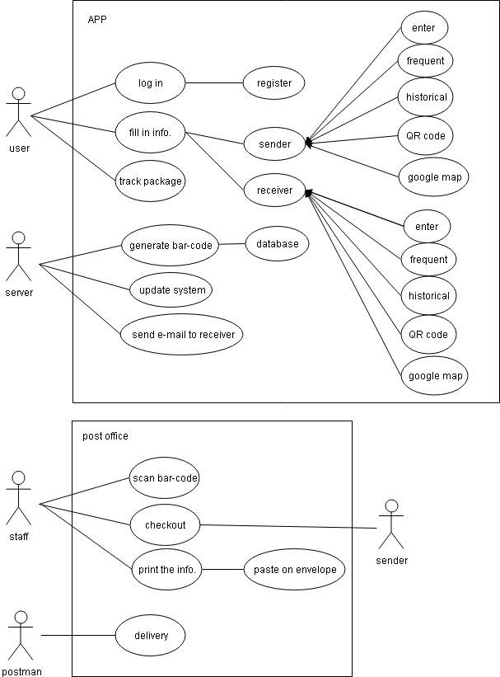
Use case diagram 1

Slide 4
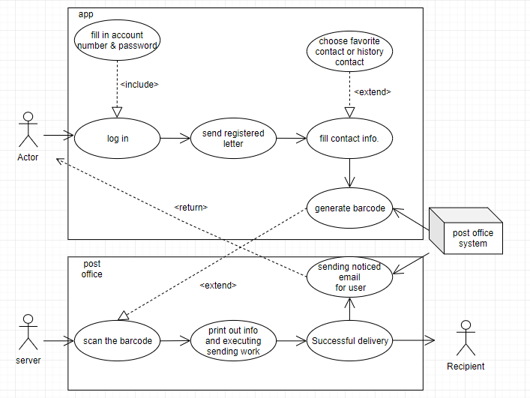
Use case diagram 2

Slide 5
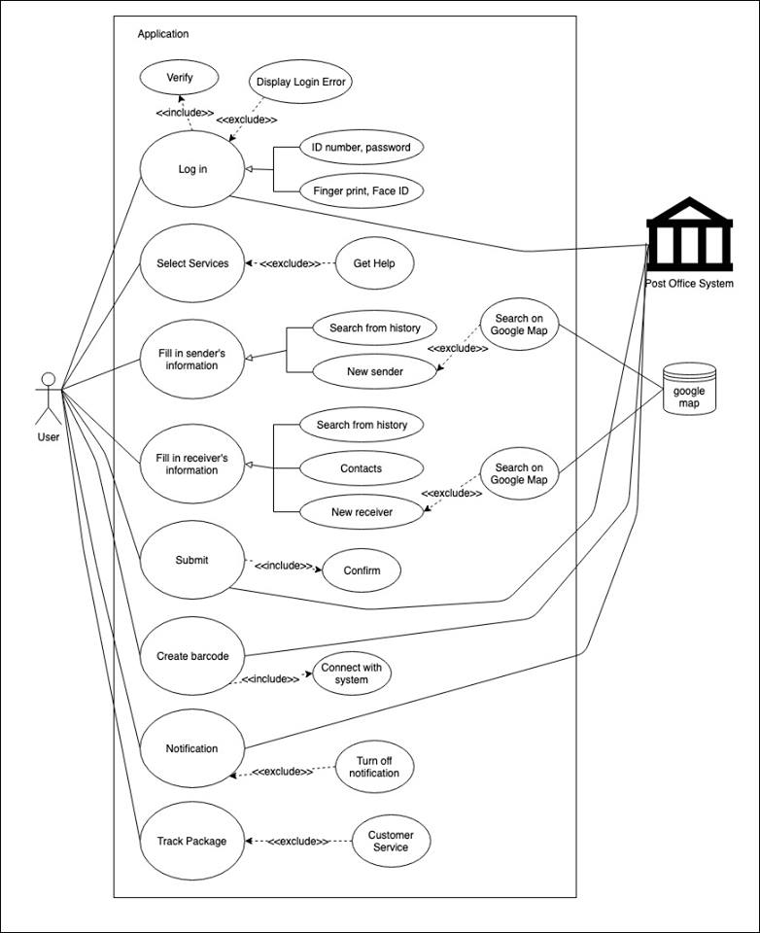
Use case diagram 3

Slide 6
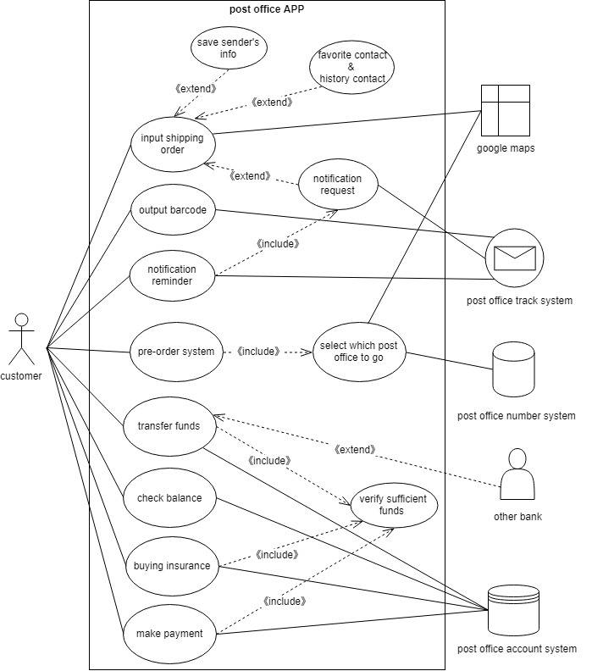
Use case diagram 4

Slide 7
Sequence diagram

Slide 8
Sequence diagram 1 (correspond to use case diagram3)

Slide 9
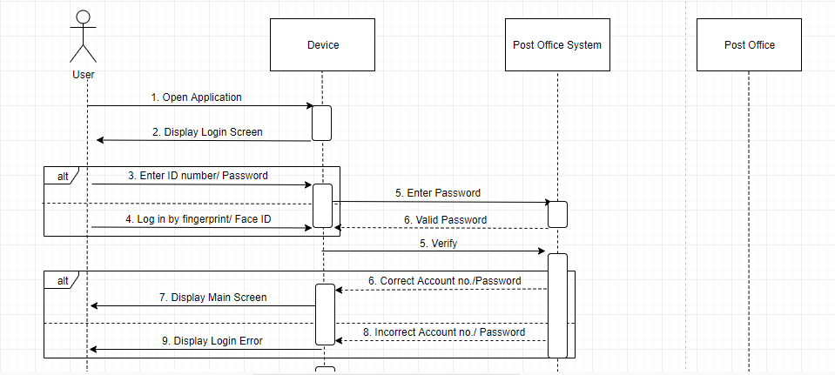

Slide 10
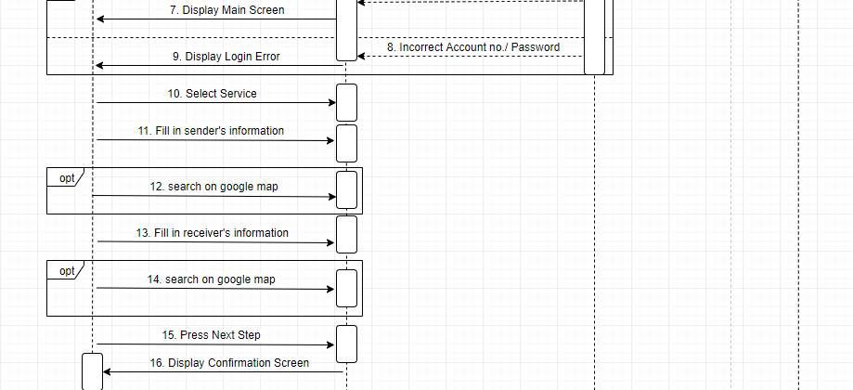

Slide 11
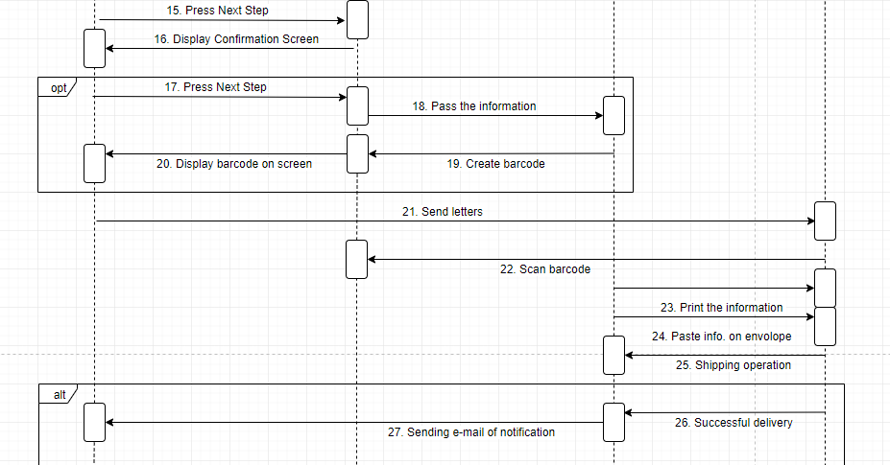

Slide 12
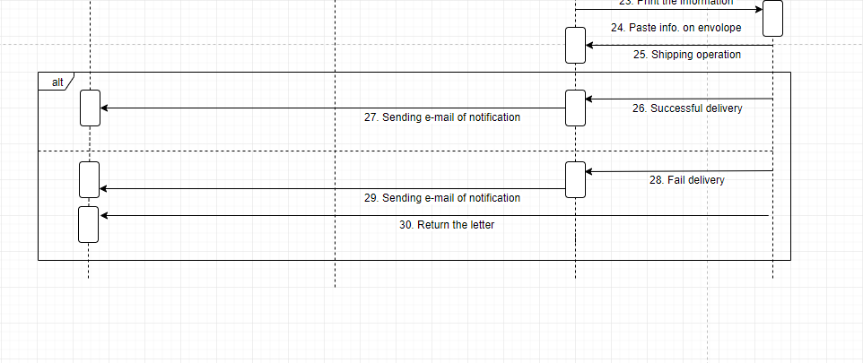

Slide 13
Sequence diagram 2 (correspond to use case diagram4)

Slide 14
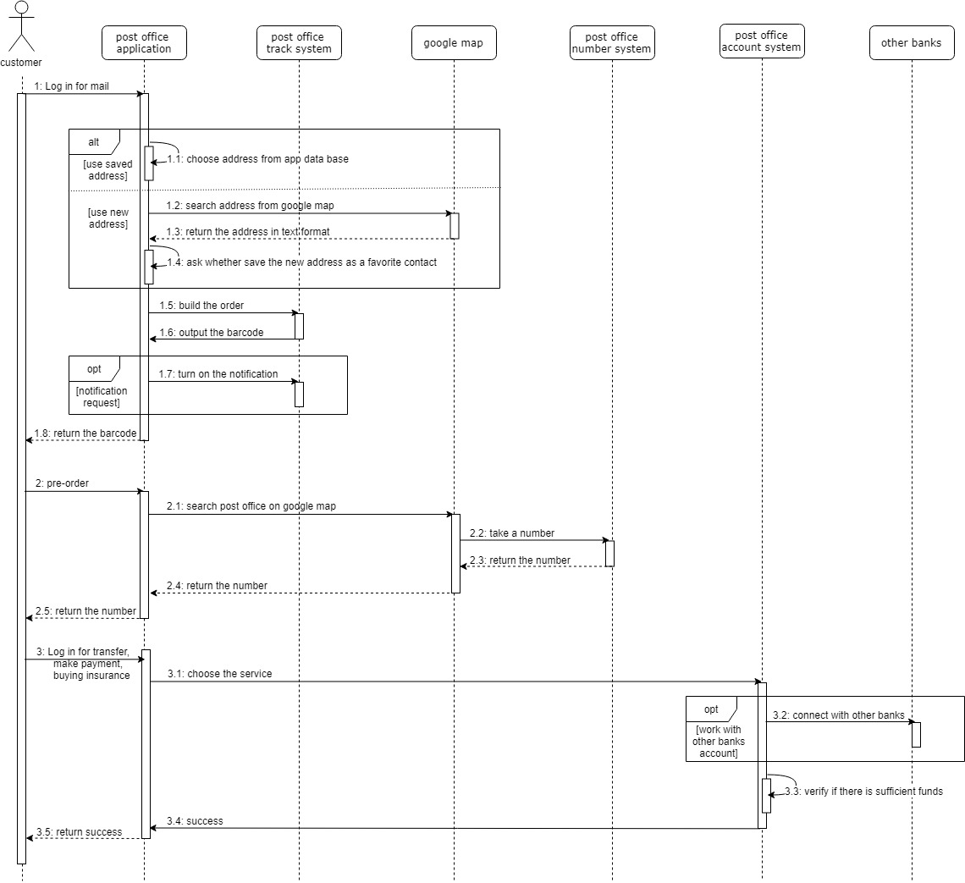

Slide 16
Thanks!

